Slide 1
BULK BOLLARD
First Order Proposal
Direct-to-Manufacturer Partnership with ZASP
Source 4 Industries | October 2025

Slide 2
Executive Summary
62%
29% → 72%
$186K
Cost Reduction
Margin Improvement
Annual Profit Boost
• Transitioning from 1-800 Bollards to direct ZASP for 10 high value bollards
• $140,087 total cost savings on 500-unit comparison (62% reduction)
• Recommended initial order: 198 units totaling $33,599
• Investment payback period: Less than 2 months
• Proven demand: 1,875 units sold over 35 months

Slide 3
Wholesale Pricing: ZASP vs 1-800 Bollards
Product | MSRP | ZASP CPU | 1-800 CPU | Savings | 1-800 Margin | ZASP Margin
4" STAINLESS STEEL REMOVABLE Bollard RPSS4040+ESV40 | $595.00 | $187.30 | $474.51 | $287.21 | 20.3% | 68.5%
6" STAINLESS STEEL REMOVABLE Bollard RPSS6040+ESV60 | $897.00 | $257.14 | $670.51 | $413.37 | 25.2% | 71.3%
4" CARBON STEEL REMOVABLE Bollard RPCS4040+ESV40 | $289.00 | $108.00 | $290.51 | $182.51 | -0.5% | 62.6%
6" CARBON STEEL REMOVABLE Bollard RPCS6040+ESV60 | $560.00 | $125.00 | $420.52 | $295.52 | 24.9% | 77.7%
4" CARBON STEEL RETRACTABLE Bollard MRCS4040-Y | $935.00 | $222.22 | $550.25 | $328.03 | 41.1% | 76.2%
4" STAINLESS STEEL RETRACTABLE Bollard MRSS4040 | $1400.00 | $274.60 | $1025.26 | $750.66 | 26.8% | 80.4%
4" BASEPLATE CARBON STEEL - 36" Bollard BCSV404036 | $199.25 | $65.00 | $84.26 | $19.26 | 57.7% | 67.4%
6" BASEPLATE CARBON STEEL - 36" Bollard BCSV604036 | $235.25 | $100.00 | $164.26 | $64.26 | 30.2% | 57.5%
4" BASEPLATE STAINLESS STEEL - 36" Bollard BSSV404036 | $350.25 | $169.84 | $283.26 | $113.42 | 19.1% | 51.5%
6" BASEPLATE STAINLESS STEEL - 36" Bollard BSSV604036 | $599.25 | $204.76 | $552.26 | $347.50 | 7.8% | 65.8%
Total Cost Savings: $140,087 (62%) | ZASP Margin: 72% vs 1-800 Margin: 29%

Slide 4
35 Month Sales for Sampled SKUs
1,875
53.6
$1,136,817
$558,569
Total Units
Monthly Avg
Revenue
ZASP Extra Profit
Product | Units Sold | Avg Units/Mo | Revenue | Monthly Revenue | ZASP Extra Profit | ZASP Monthly Extra Profit
4" STAINLESS STEEL REMOVABLE Bollard | 297 | 8.5 | $192,051 | $5,487 | $85,301 | $2,437
6" STAINLESS STEEL REMOVABLE Bollard | 106 | 3.0 | $95,680 | $2,734 | $43,817 | $1,252
4" CARBON STEEL REMOVABLE Bollard | 499 | 14.3 | $219,680 | $6,277 | $91,072 | $2,602
6" CARBON STEEL REMOVABLE Bollard | 383 | 10.9 | $231,166 | $6,605 | $113,184 | $3,234
4" CARBON STEEL RETRACTABLE Bollard | 209 | 6.0 | $149,525 | $4,272 | $68,558 | $1,959
4" STAINLESS STEEL RETRACTABLE Bollard | 125 | 3.6 | $120,317 | $3,438 | $93,832 | $2,681
4" BASEPLATE CARBON STEEL - 36" Bollard | 26 | 0.7 | $3,201 | $91 | $501 | $14
6" BASEPLATE CARBON STEEL - 36" Bollard | 17 | 0.5 | $7,566 | $216 | $1,092 | $31
4" BASEPLATE STAINLESS STEEL - 36" Bollard | 121 | 3.5 | $37,781 | $1,079 | $13,724 | $392
6" BASEPLATE STAINLESS STEEL - 36" Bollard | 92 | 2.6 | $48,271 | $1,379 | $31,970 | $913
TOTAL | 1875 | 53.6 | $1,105,239 | $31,578 | $543,053 | $15,516

Slide 5
2025 Sales for Sampled SKUs
421
46.8
$317,161
$145,877
Total Units
Monthly Avg
Revenue
ZASP Extra Profit
Product | Units Sold | Avg Units/Mo | Revenue | Monthly Revenue | ZASP Extra Profit | ZASP Monthly Extra Profit
4" STAINLESS STEEL REMOVABLE Bollard | 68 | 7.6 | $40,259 | $4,473 | $19,530 | $2,170
6" STAINLESS STEEL REMOVABLE Bollard | 28 | 3.1 | $25,116 | $2,791 | $11,574 | $1,286
4" CARBON STEEL REMOVABLE Bollard | 24 | 2.7 | $10,269 | $1,141 | $4,380 | $487
6" CARBON STEEL REMOVABLE Bollard | 63 | 7.0 | $36,724 | $4,080 | $18,618 | $2,069
4" CARBON STEEL RETRACTABLE Bollard | 87 | 9.7 | $61,814 | $6,868 | $28,539 | $3,171
4" STAINLESS STEEL RETRACTABLE Bollard | 57 | 6.3 | $63,226 | $7,025 | $42,788 | $4,754
4" BASEPLATE CARBON STEEL - 36" Bollard | 4 | 0.4 | $797 | $89 | $77 | $9
6" BASEPLATE CARBON STEEL - 36" Bollard | 90 | 10.0 | $47,240 | $5,249 | $5,783 | $643
4" BASEPLATE STAINLESS STEEL - 36" Bollard | 0 | 0.0 | $0 | $0 | $0 | $0
6" BASEPLATE STAINLESS STEEL - 36" Bollard | 0 | 0.0 | $0 | $0 | $0 | $0
TOTAL | 421 | 46.8 | $285,444 | $31,716 | $131,289 | $14,588

Slide 6
Order Analytics
$3,110
4.8
$818
$331
Avg Order Value
Bollards/Order
Profit Per Order
Avg Shipping
Category | AOV | Per Order | Profit Per Order | Margin | Orders | Refund % | Discount %
Crash Rated | $9977.33 | 9.6 | $2218.75 | 22.2% | 13.5 | 0.00% | 1.49%
Fixed | $4496.53 | 10.2 | $957.08 | 21.3% | 39.3 | -1.46% | 3.44%
Removable | $3110.46 | 4.8 | $817.71 | 26.3% | 320.1 | -0.55% | 2.63%
Retractable | $4437.37 | 5.5 | $1271.18 | 28.6% | 74.6 | -0.60% | 6.82%
Sampled SKUs Profit Per Order
Product SKU | Per Order | AOV | Profit Per Order | Margin | Discount %
RPCS6040+ESV60 | 3.8 | $2497.87 | $624.51 | 25.0% | 3.39%
RPCS4040+ESV40 | 4.3 | $2165.73 | $688.70 | 31.8% | 2.26%
RPSS4040+ESV40 | 6.0 | $4020.10 | $951.82 | 23.7% | 2.53%
MRCS4040-Y | 10.5 | $6976.76 | $1873.83 | 26.9% | 12.80%
MRSS4040 | 4.2 | $4205.58 | $1276.55 | 30.4% | 2.24%
RPSS6040+ESV60 | 5.6 | $5215.30 | $1239.59 | 23.8% | 2.52%
BSSV604036 | 18.4 | $10108.22 | $1760.19 | 17.4% | 4.27%
BSSV404036 | 12.6 | $3879.42 | $775.16 | 20.0% | 6.99%
BCSV604036 | 9.3 | $2997.61 | $703.37 | 23.5% | 2.31%
BCSV404036 | 13.1 | $2721.23 | $507.65 | 18.7% | 7.51%

Slide 7
Recommended Initial Order
Data-driven: 35-month velocity + 2025 trends | 6-month supply (high velocity), 4-month (medium), 3-month (lower)
Product | Avg/Month | Supply | Order Qty | Unit Cost | Total
6" CARBON STEEL REMOVABLE | 8.6 | 4mo | 35 | $125 | $4,375
4" CARBON STEEL RETRACTABLE | 8.2 | 4mo | 35 | $222 | $7,778
4" STAINLESS STEEL REMOVABLE | 7.9 | 4mo | 30 | $187 | $5,619
4" CARBON STEEL REMOVABLE | 7.3 | 4mo | 30 | $108 | $3,240
6" BASEPLATE CARBON STEEL - 36" | 6.2 | 4mo | 25 | $100 | $2,500
4" STAINLESS STEEL RETRACTABLE | 5.2 | 4mo | 20 | $275 | $5,492
6" STAINLESS STEEL REMOVABLE | 3.1 | 3mo | 9 | $257 | $2,314
Monthly | 1.5 | 3mo | 5 | $171 | $857
4" BASEPLATE STAINLESS STEEL - 3 | 1.4 | 3mo | 4 | $170 | $679
6" BASEPLATE STAINLESS STEEL - 3 | 1.1 | 3mo | 3 | $205 | $614
RECOMMENDED ORDER: 198 units | Total Investment: $33,598.53 | Payback: <2 months

Slide 8
Financial Impact Analysis
ANNUAL IMPACT
+$186,186 Additional Profit
214% Profit Increase | 49% Margin Improvement | <2 Month ROI
CURRENT STATE
1-800 Bollards Distributor
Monthly Profit $7,257
Annual Profit $87,084
Gross Margin 23%
WITH ZASP DIRECT
Direct Manufacturing
Monthly Profit $22,773
Annual Profit $273,270
Gross Margin 72%

Slide 9
Market Opportunity & Search Demand
Keyword research reveals 74,000 monthly searches with explosive growth opportunities
74,000
$3.5B
$4.5B
6-8%
Total Searches/Mo
Market Size
2030 Projection
CAGR
Top Growth Keywords & Opportunities:
• Fixed Bollards: 590/mo (+3,329% YoY) - LOW competition - HIGHEST PRIORITY
• Crash-Rated Bollards: 390/mo (+243% YoY) - Security focus driving demand
• Parking Lot Bollards: 1,000/mo (+48% YoY) - Commercial growth
• Yellow Bollards: 590/mo (+50% YoY) - Safety/visibility trending
• Security Bollards: 1,300/mo (+22% YoY) - High commercial intent
• Removable Parking Bollards: 170/mo (+40% YoY) - Flexible access control
Market Shift: Commercial/Parking Growing (+26-48%) | Residential Declining (-55%)
Strategic Implications:
• Fixed bollards represent unprecedented SEO opportunity aligning with our 4 baseplate products
• Commercial focus matches our wholesale strategy and bulk order approach
• Strong search demand validates proven sales history and supports scaling plan

Slide 10
Market Competitive Analysis
Real competitor pricing: 1-800 Bollards, Global Industrial, Polector, U-Line
Product | ZASP | S4 MSRP | 1-800 | Global | Polector | U-Line | S4 New Price | S4 New Margin
4" STAINLESS STEEL REMOVABLE Bollard | $187.30 | $595.00 | $474.51 | $1099.00 | $595.95 | - | $595 | 68.50%
6" STAINLESS STEEL REMOVABLE Bollard | $257.14 | $897.00 | $670.51 | $1499.00 | $904.95 | - | $897 | 71.30%
4" CARBON STEEL REMOVABLE Bollard | $108.00 | $475.00 | $290.51 | $285.95 | $484.95 | - | $285 | 62.10%
6" CARBON STEEL REMOVABLE Bollard | $125.00 | $560.00 | $420.52 | $355.95 | $564.95 | - | $355 | 64.80%
4" CARBON STEEL RETRACTABLE Bollard | $222.22 | $935.00 | $550.25 | - | - | - | $750 | 70.40%
4" STAINLESS STEEL RETRACTABLE Bollard | $274.60 | $1400.00 | $1025.26 | - | - | - | $1400 | 80.40%
4" BASEPLATE CARBON STEEL - 36" Bollard | $65.00 | $184.95 | $84.26 | $109.95 | - | $95.00 | $129 | 49.60%
6" BASEPLATE CARBON STEEL - 36" Bollard | $100.00 | $260.25 | $164.26 | - | - | $150.00 | $199 | 49.70%
4" BASEPLATE STAINLESS STEEL - 36" Bollard | $169.84 | $350.25 | $283.26 | $165.95 | - | $280.00 | $299 | 43.20%
6" BASEPLATE STAINLESS STEEL - 36" Bollard | $204.76 | $599.25 | $552.26 | $569.00 | - | - | $549 | 62.70%
ZASP pricing enables 50-80% margin improvement while remaining competitive. Our new pricing maintains market positioning with significantly higher profitability.

Slide 11
Recommendation & Next Steps
PROCEED WITH INITIAL ORDER
198 units from ZASP for $33,599
KEY BENEFITS
✓ 62% cost reduction vs 1-800 Bollards distributor
✓ Margin improvement from 23% to 72%
✓ Additional $186K annual profit at current velocity
✓ Investment payback in less than 2 months
✓ 3-6 months inventory coverage based on product velocity
✓ Strong market demand: 74,000 monthly searches with explosive growth
Next: Finalize ZASP agreement → Place initial order → Scale to container-level orders

Slide 12
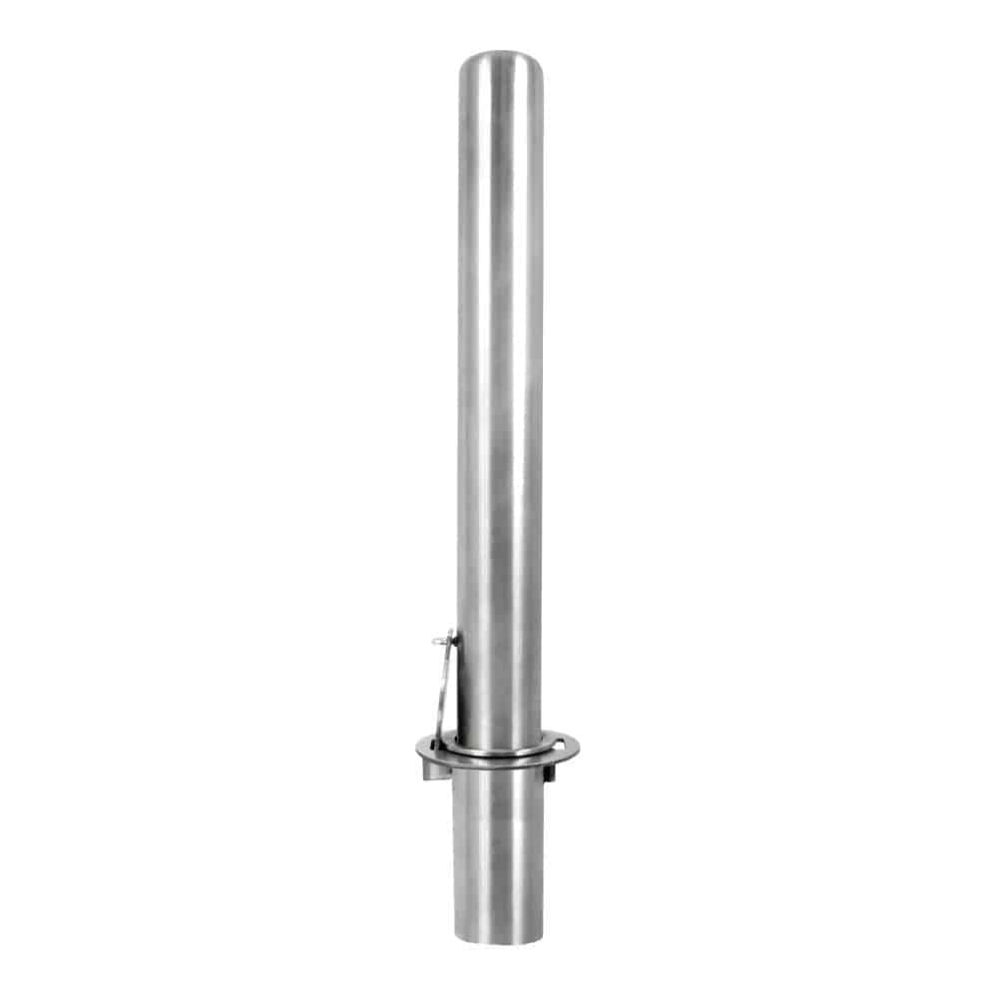
4" Removable Stainless Steel Bollard
SKU: RPSS4040+ESV40
Opportunity Score: TBD
Conservative Monthly Profit Impact: TBD
Moderate Monthly Profit Impact: TBD
Optimistic Monthly Profit Impact: TBD
SALES DATA
Year
Orders
QTY Sold
Avg Sale Price
Avg CPU
Sales Total
Profit Total
2023
TBD
TBD
TBD
TBD
TBD
TBD
2024
TBD
TBD
TBD
TBD
TBD
TBD
2025
TBD
TBD
TBD
TBD
TBD
TBD
Total
49.8
297
$646.64
$462.68
$192,051
$47,401
CURRENT PRICING & COMPETITION
Current CPU
$462.68
ZASP CPU
TBD
Current MSRP
TBD
Comp. CPU
TBD
Profit Impact
TBD
RECOMMENDATIONS
New MSRP
TBD
New Margin
TBD
Est. Monthly Vol.
TBD
Profit Monthly
TBD
ORDER PROJECTIONS
First Order Qty
TBD
Sell Out Time
TBD
Short Profit Lift
TBD
Long Profit Lift
TBD
NOTES
Add product-specific notes and strategic considerations here.

Slide 13
[Add Image Here]
Delete this box
and insert image
4" Removable Carbon Steel Bollard with Embedment Sleeve (36 Inch Height)
[Add Image Here]
Delete this box
and insert image
6" Removable Carbon Steel Bollard with Embedment Sleeve
SKU: RPCS4040+ESV40
SKU: RPCS6040+ESV60
Opportunity Score: TBD
Opportunity Score: TBD
Conservative Monthly Profit Impact: TBD
Conservative Monthly Profit Impact: TBD
Moderate Monthly Profit Impact: TBD
Moderate Monthly Profit Impact: TBD
Optimistic Monthly Profit Impact: TBD
Optimistic Monthly Profit Impact: TBD
SALES DATA
SALES DATA
Year
Orders
QTY Sold
Sales Total
Profit Total
Avg Sale Price
Avg CPU
Year
Orders
QTY Sold
Sales Total
Profit Total
Avg Sale Price
Avg CPU
2023
TBD
TBD
TBD
TBD
TBD
TBD
2023
TBD
TBD
TBD
TBD
TBD
TBD
2024
TBD
TBD
TBD
TBD
TBD
TBD
2024
TBD
TBD
TBD
TBD
TBD
TBD
2025
TBD
TBD
TBD
TBD
TBD
TBD
2025
TBD
TBD
TBD
TBD
TBD
TBD
Total
116.8
499
$219,680
$80,441
$440.24
$269.08
Total
101.7
383
$231,166
$63,512
$603.57
$412.53
CURRENT PRICING & COMPETITION
CURRENT PRICING & COMPETITION
Current CPU
$269.08
ZASP CPU
TBD
Current MSRP
TBD
Comp. CPU
TBD
Profit Impact
TBD
Current CPU
$412.53
ZASP CPU
TBD
Current MSRP
TBD
Comp. CPU
TBD
Profit Impact
TBD
RECOMMENDATIONS
RECOMMENDATIONS
New MSRP
TBD
New Margin
TBD
Est. Monthly Vol.
TBD
Profit Monthly
TBD
New MSRP
TBD
New Margin
TBD
Est. Monthly Vol.
TBD
Profit Monthly
TBD
ORDER PROJECTIONS
ORDER PROJECTIONS
First Order Qty
TBD
Sell Out Time
TBD
Short Profit Lift
TBD
Long Profit Lift
TBD
First Order Qty
TBD
Sell Out Time
TBD
Short Profit Lift
TBD
Long Profit Lift
TBD
NOTES
NOTES
Add product-specific notes and strategic considerations here.
Add product-specific notes and strategic considerations here.

Slide 14
[Add Image Here]
Delete this box
and insert image
4" Manual Retractable Yellow Carbon Steel Bollard (36" Height)
[Add Image Here]
Delete this box
and insert image
4" Manual Retractable Stainless Steel Bollard (36" Height)
SKU: MRCS4040-Y
SKU: MRSS4040
Opportunity Score: TBD
Opportunity Score: TBD
Conservative Monthly Profit Impact: TBD
Conservative Monthly Profit Impact: TBD
Moderate Monthly Profit Impact: TBD
Moderate Monthly Profit Impact: TBD
Optimistic Monthly Profit Impact: TBD
Optimistic Monthly Profit Impact: TBD
SALES DATA
SALES DATA
Year
Orders
QTY Sold
Sales Total
Profit Total
Avg Sale Price
Avg CPU
Year
Orders
QTY Sold
Sales Total
Profit Total
Avg Sale Price
Avg CPU
2023
TBD
TBD
TBD
TBD
TBD
TBD
2023
TBD
TBD
TBD
TBD
TBD
TBD
2024
TBD
TBD
TBD
TBD
TBD
TBD
2024
TBD
TBD
TBD
TBD
TBD
TBD
2025
TBD
TBD
TBD
TBD
TBD
TBD
2025
TBD
TBD
TBD
TBD
TBD
TBD
Total
20.0
209
$149,525
$37,477
$715.43
$444.57
Total
29.6
125
$120,317
$37,786
$962.54
$622.97
CURRENT PRICING & COMPETITION
CURRENT PRICING & COMPETITION
Current CPU
$444.57
ZASP CPU
TBD
Current MSRP
TBD
Comp. CPU
TBD
Profit Impact
TBD
Current CPU
$622.97
ZASP CPU
TBD
Current MSRP
TBD
Comp. CPU
TBD
Profit Impact
TBD
RECOMMENDATIONS
RECOMMENDATIONS
New MSRP
TBD
New Margin
TBD
Est. Monthly Vol.
TBD
Profit Monthly
TBD
New MSRP
TBD
New Margin
TBD
Est. Monthly Vol.
TBD
Profit Monthly
TBD
ORDER PROJECTIONS
ORDER PROJECTIONS
First Order Qty
TBD
Sell Out Time
TBD
Short Profit Lift
TBD
Long Profit Lift
TBD
First Order Qty
TBD
Sell Out Time
TBD
Short Profit Lift
TBD
Long Profit Lift
TBD
NOTES
NOTES
Add product-specific notes and strategic considerations here.
Add product-specific notes and strategic considerations here.

Slide 15
[Add Image Here]
Delete this box
and insert image
4" Carbon Steel Dome Top Bollard with Baseplate
[Add Image Here]
Delete this box
and insert image
6" Carbon Steel Dome Top Bollard with Baseplate
SKU: BCSV404036
SKU: BCSV604036
Opportunity Score: TBD
Opportunity Score: TBD
Conservative Monthly Profit Impact: TBD
Conservative Monthly Profit Impact: TBD
Moderate Monthly Profit Impact: TBD
Moderate Monthly Profit Impact: TBD
Optimistic Monthly Profit Impact: TBD
Optimistic Monthly Profit Impact: TBD
SALES DATA
SALES DATA
Year
Orders
QTY Sold
Sales Total
Profit Total
Avg Sale Price
Avg CPU
Year
Orders
QTY Sold
Sales Total
Profit Total
Avg Sale Price
Avg CPU
2023
TBD
TBD
TBD
TBD
TBD
TBD
2023
TBD
TBD
TBD
TBD
TBD
TBD
2024
TBD
TBD
TBD
TBD
TBD
TBD
2024
TBD
TBD
TBD
TBD
TBD
TBD
2025
TBD
TBD
TBD
TBD
TBD
TBD
2025
TBD
TBD
TBD
TBD
TBD
TBD
Total
1.3
17
$3,201
$660
$188.31
$135.35
Total
2.8
26
$7,566
$1,969
$291.00
$208.54
CURRENT PRICING & COMPETITION
CURRENT PRICING & COMPETITION
Current CPU
$135.35
ZASP CPU
TBD
Current MSRP
TBD
Comp. CPU
TBD
Profit Impact
TBD
Current CPU
$208.54
ZASP CPU
TBD
Current MSRP
TBD
Comp. CPU
TBD
Profit Impact
TBD
RECOMMENDATIONS
RECOMMENDATIONS
New MSRP
TBD
New Margin
TBD
Est. Monthly Vol.
TBD
Profit Monthly
TBD
New MSRP
TBD
New Margin
TBD
Est. Monthly Vol.
TBD
Profit Monthly
TBD
ORDER PROJECTIONS
ORDER PROJECTIONS
First Order Qty
TBD
Sell Out Time
TBD
Short Profit Lift
TBD
Long Profit Lift
TBD
First Order Qty
TBD
Sell Out Time
TBD
Short Profit Lift
TBD
Long Profit Lift
TBD
NOTES
NOTES
Add product-specific notes and strategic considerations here.
Add product-specific notes and strategic considerations here.

Slide 16
[Add Image Here]
Delete this box
and insert image
4" Stainless Steel Dome Top Bollard with Baseplate (36" Height)
[Add Image Here]
Delete this box
and insert image
6" Stainless Steel Dome Top Bollard with Baseplate
SKU: BSSV404036
SKU: BSSV604036
Opportunity Score: TBD
Opportunity Score: TBD
Conservative Monthly Profit Impact: TBD
Conservative Monthly Profit Impact: TBD
Moderate Monthly Profit Impact: TBD
Moderate Monthly Profit Impact: TBD
Optimistic Monthly Profit Impact: TBD
Optimistic Monthly Profit Impact: TBD
SALES DATA
SALES DATA
Year
Orders
QTY Sold
Sales Total
Profit Total
Avg Sale Price
Avg CPU
Year
Orders
QTY Sold
Sales Total
Profit Total
Avg Sale Price
Avg CPU
2023
TBD
TBD
TBD
TBD
TBD
TBD
2023
TBD
TBD
TBD
TBD
TBD
TBD
2024
TBD
TBD
TBD
TBD
TBD
TBD
2024
TBD
TBD
TBD
TBD
TBD
TBD
2025
TBD
TBD
TBD
TBD
TBD
TBD
2025
TBD
TBD
TBD
TBD
TBD
TBD
Total
9.6
121
$37,781
$7,442
$312.24
$219.00
Total
5.0
92
$48,271
$8,801
$524.68
$406.60
CURRENT PRICING & COMPETITION
CURRENT PRICING & COMPETITION
Current CPU
$219.00
ZASP CPU
TBD
Current MSRP
TBD
Comp. CPU
TBD
Profit Impact
TBD
Current CPU
$406.60
ZASP CPU
TBD
Current MSRP
TBD
Comp. CPU
TBD
Profit Impact
TBD
RECOMMENDATIONS
RECOMMENDATIONS
New MSRP
TBD
New Margin
TBD
Est. Monthly Vol.
TBD
Profit Monthly
TBD
New MSRP
TBD
New Margin
TBD
Est. Monthly Vol.
TBD
Profit Monthly
TBD
ORDER PROJECTIONS
ORDER PROJECTIONS
First Order Qty
TBD
Sell Out Time
TBD
Short Profit Lift
TBD
Long Profit Lift
TBD
First Order Qty
TBD
Sell Out Time
TBD
Short Profit Lift
TBD
Long Profit Lift
TBD
NOTES
NOTES
Add product-specific notes and strategic considerations here.
Add product-specific notes and strategic considerations here.

